Slide 1
About Emergency Voice Communication (EVC) Systems
‘beyond expectations’

Slide 2
Emergency Voice Communication what is it?
Secure, monitored audio communication compliant to British Standards:
Fire Telephone System.
Disabled Refuge System (DRS).
Emergency/Steward Telephone System.
Disabled Toilet Alarm (DTA).
With Omnicare & CARE2 - all wired on ONE common network

Slide 3
Emergency Voice Communication why is it needed?
To conform with national standards and building codes.
To communicate with ‘emergency personnel’, ensuring a controlled evacuation.
To communicate with ALL occupants within a building, to assist and reassure throughout an emergency.
To communicate with occupants of ‘Refuge Areas’.
Minimises panic and confusion

Slide 4
Equality Act 2010 Replaced the Disability Discrimination Act (DDA)
Who is responsible?
Public service providers or building occupiers/management.
Key Point?
“Accessibility for ALL”.
What does this mean?
Access to all goods, facilities & services of a company must be available to all.
There must be “no discrimination”

Slide 5
British Standard BS9999:2008
Applies to all non domestic buildings above one storey.
A fire control centre should be provided in all buildings designed for phased evacuation and in large or complex buildings.
The fire control centre should be either:
A room dedicated solely as a fire control centre, or
Combined with the management control room.
Throughout the building a reliable means of communication with the fire control centre should be provided.
The fire control centre communication system should provide direct links to fire fighting lobbies/fire service access points and disabled refuge areas.
Fire marshalls/wardens should use fire telephones to report a floor evacuation is complete and/or report the fire situation on that floor.
Code of practice for fire safety in the design, management and use of buildings
What is the Standard?

Slide 6
British Standard BS9999:2008
Refuge areas need to be provided on all storeys, except where there is a level access to a final exit.
Defines ‘refuge’ as an enclosed fire-resisting area, served directly by safe route to an exit.
People in each refuge need to be assured that their presence is known to the building management. To address this there must be a system of two-way communication.
The two-way communication system must be readily operated by, and comprehensible to all persons likely to use it and conform to BS5839-9.
Omnicare & CARE2 assist companies with compliance to the guidelines of BS9999:2008
Continued..

Slide 7
Refuge Area Definition
A safe place for disabled to await assistance for their evacuation.
An enclosed area of fire-resisting construction.
Must be served directly by a safe route of exit.
Minimum size = 900mm x 1400mm – sufficient space for wheelchair to manoeuvre.
Minimum of 30 minutes fire-resisting separation.
Wheelchair space should not reduce the width of escape route.
Wheelchair space must not obstruct flow of persons escaping.

Slide 8
British Standard BS5839-9:2011
The Standard provides guidelines for the use of an Emergency Voice Communication (EVC) system.
It defines intended uses for an EVC:
Use by the management of the building for initial evacuation.
Use by the fire service during an evacuation.
Use by the fire service after an evacuation.
Use by disabled people.
As a ‘listen in’ device.
Use by members of the public.
BS5839-9:2011 specifies the type of equipment that should be employed for EVC systems and how they must be designed and implemented.
Omnicare & CARE2 fully comply to the guidelines of BS5839-9:2011
Fire detection and fire alarm systems for buildings – code of practice for emergency voice communication systems
What is the Standard?

Slide 9
Types of remote
BS5839-9:2011 specifies two types of remote (outstation):
Type A:
Traditional telephone handset.
True two-way conversation.
For use for evacuation or fire fighting.
Should be red in colour (or red signage).
Type B:
Hands-free operation.
For use by disabled persons.
For use by the public.
Should be green in colour (or green signage).

Slide 10
British Standard BS8300:2009
BS8300:2009 requires a disabled toilet to be fitted with a suitable alarm, the key points being:
There should be a visual and audible call acknowledge/action feedback.
Designed so as not to be confused, visually or audibly, with a fire alarm.
Emergency red pull cord must be provided with two 50mm diameter red loops.
Must enable calls for assistance to be made, even if the person has fallen to the floor.
An audible/visual indication positioned outside the room/compartment so that it is easily seen. (An additional alarm indicator may also be sited remotely e.g. in a permanently staffed area.)
Omnicare & CARE2 assist companies with compliance to the guidelines of BS8300:2009
Design of buildings and their approaches to meet the needs of disabled people (disabled toilets)
What is the Standard?

Slide 11
Typical System Components

Slide 12
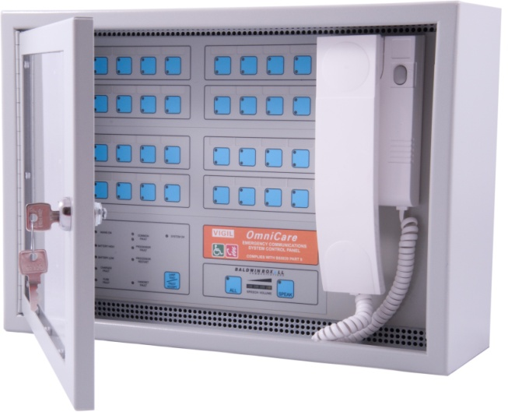
Control Panels
Typically fitted in the ‘building management’ area of a building.
Receives ‘call’ or ‘occupancy’ signals from the remotes.
Provides voice communication with the remotes on the system.
Displays system status.
Can be flush or surface mounted.

Slide 13
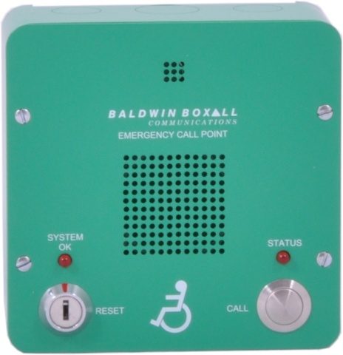
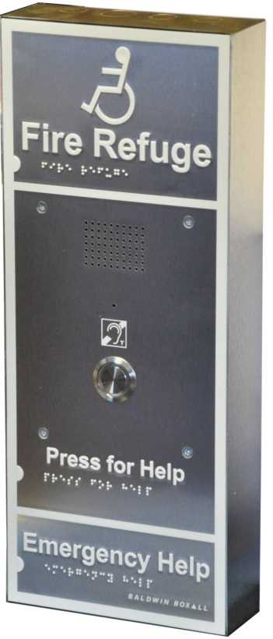
Disabled Refuge (DRS)
Call button/switch to initiate call.
Call reset at control panel (and on remote with some systems).
Hands free operation – usually speech-steered.
Some have an optional link to operate over-door lights, etc.
Green finish as requested by the Standard (other colour options such as stainless steel available but should be accompanied by a green sign for compliance).
Surface or flush mountable.

Slide 14
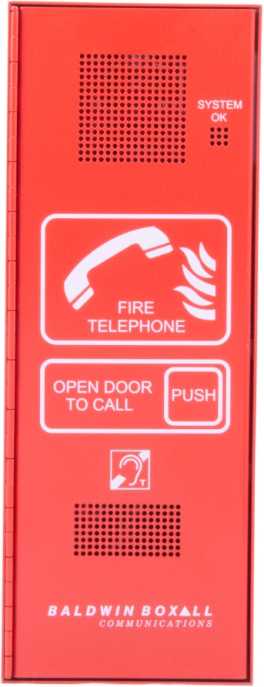
Fire Telephone
Usually a heavy duty enclosure.
Full duplex speech is normally applied.
Used by fireman/building control to report ‘clear areas’ of a building or other communication during evacuation or emergency.
Red finish as requested by the Standard (other colour options such as stainless steel available but should be accompanied by red signage for compliance).
Surface or flush mountable.

Slide 15
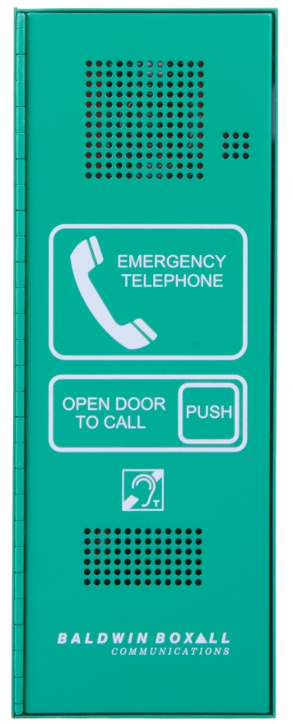
Stewards Telephone
Usually a heavy duty enclosure.
Full duplex speech is normally applied.
Used by fireman/stewards to report ‘clear areas’ of a stadium/arena or other communication during evacuation or emergency.
Green finish as requested by the Standard.
Surface or flush mountable.

Slide 16
Combined Unit
Some systems offer a combined unit.
Features a fire telephone point and a disabled refuge point.
Seen as one point on the control panel.
Surface or flush mountable.

Slide 17
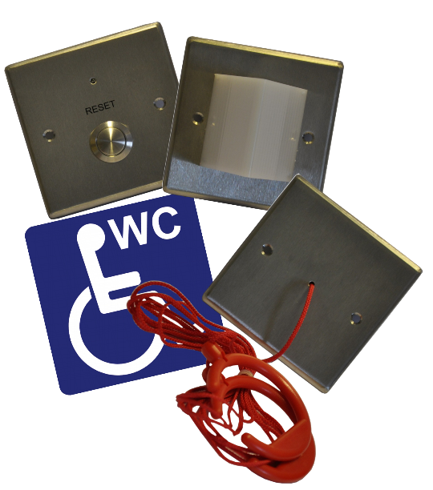
Disabled Toilet Alarm
Many EVC systems now include the ability to add disabled toilet alarm systems to the control panel.
Toilet alarm systems must comply to BS8300.

Slide 18
Typical Cabling

Slide 19
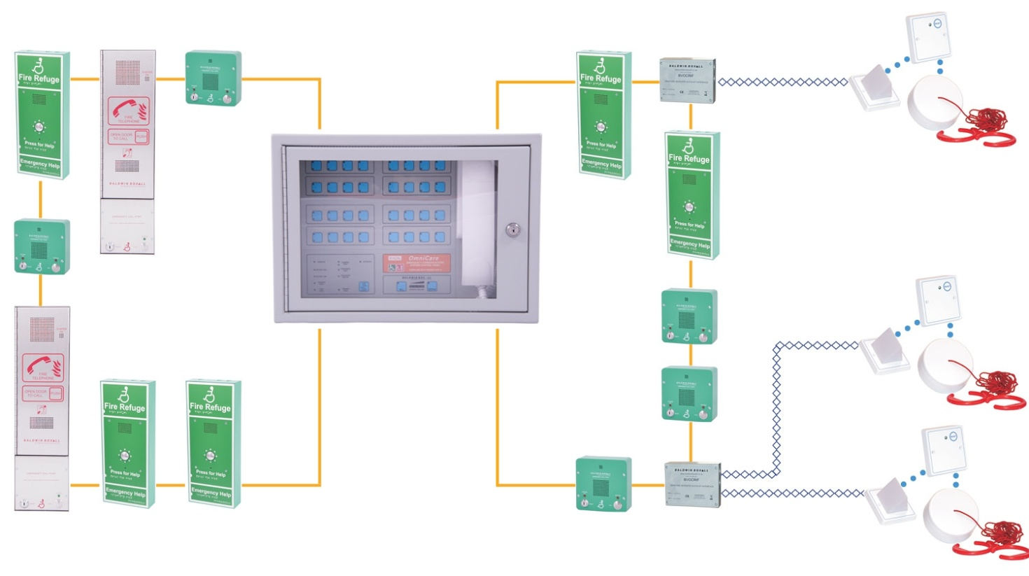
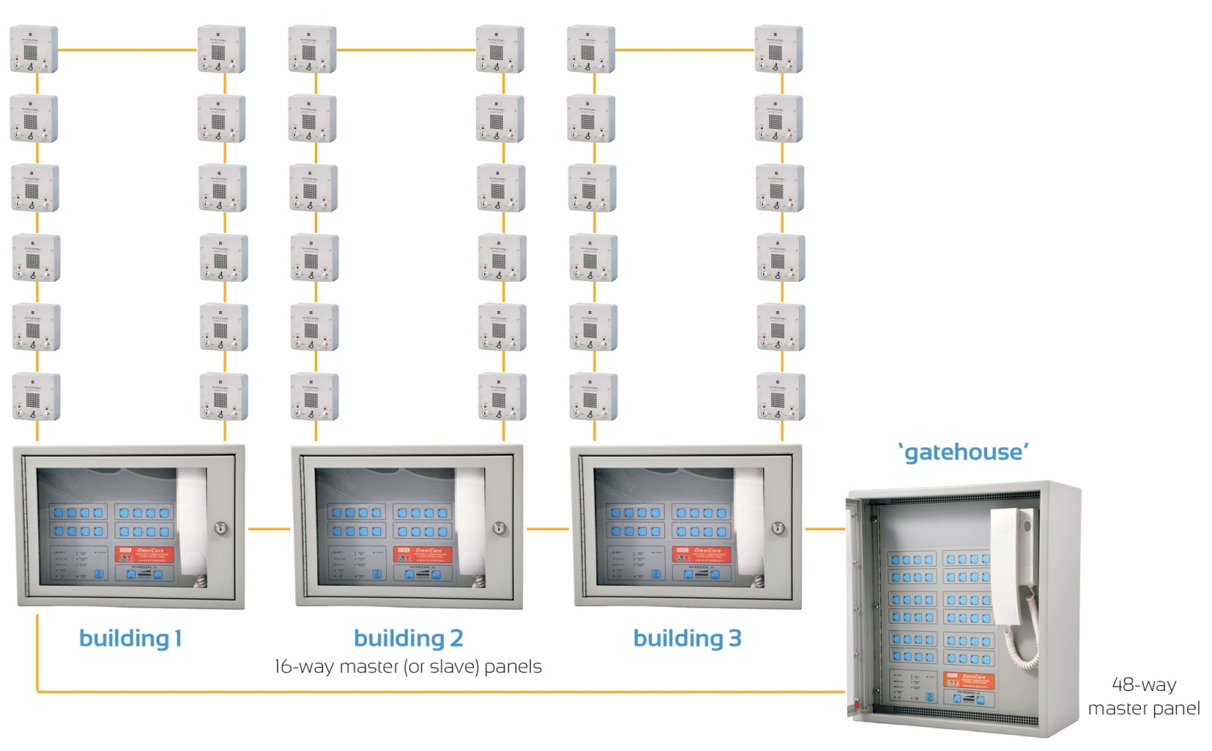
Loop Wiring

Slide 20
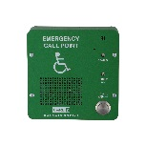
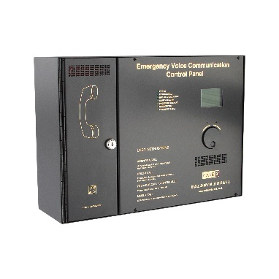
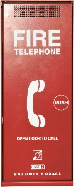
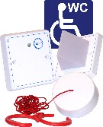
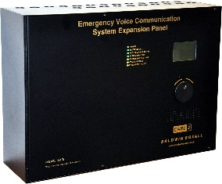
Radial Wiring

Slide 21
The CARE2 System

Slide 22
CARE2: radial wired EVC system
Simple to install and operate.
Radial (star) wired system.
Comprises of three main components:
Control Panel.
Network Expansion Panel (NEP).
Remote Units (outstations):
Disabled refuge (DRS), fire fighter telephone, emergency/steward telephone, roaming telephone handsets and disabled toilet alarm.

Slide 23
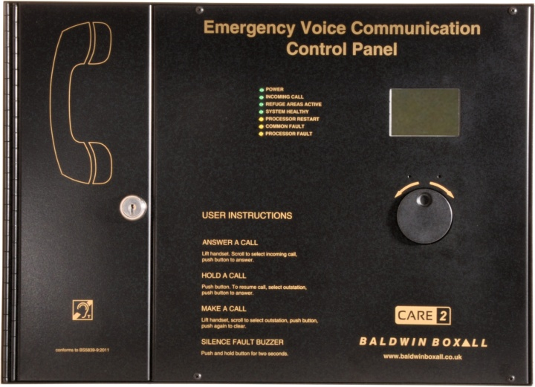
CARE2: Master Panel
4-way panel (expandable).
Optional 4-way line expansion kit (enabling 8, 12 or 16-way).
Unique, simple to use, design.
Clear LCD screen with rotary encoder.
Rugged red handset with hearing aid compatible earpiece (T-coil).
Typically fitted in the ‘building management’ area of a building.
Provides voice communication with the remotes on the system.
Up to two panels per network (one will act as a slave panel).
Black or stainless steel finish.
Can be flush or surface mounted.

Slide 24
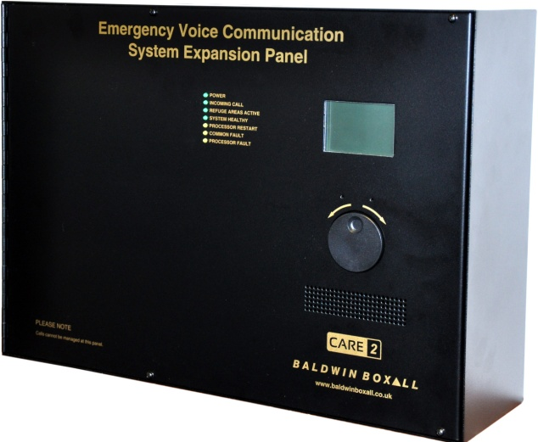
CARE2: Network Expansion Panel (NEP)
4-way panel (expandable).
Optional 4-way line expansion kit (enabling 8, 12 or 16-way).
Indicates status of local outstations.
Clear LCD screen with rotary encoder.
Fit up to 15 NEPs on a network (14 if installing two control panels).
Systems of up to 256 outstations possible.
Control panels and NEPs are wired in a loop using 2 x 2-core cable.
Black or stainless steel finish.
Can be flush or surface mounted.

Slide 25
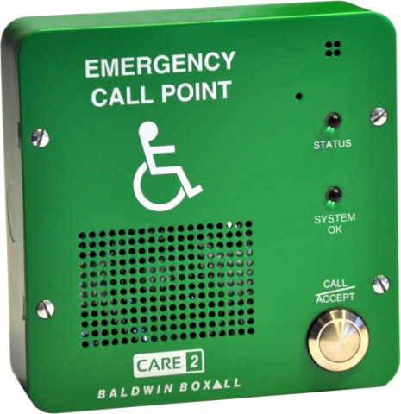
CARE2: Disabled Refuge (DRS)
Induction loop output to feed external amplifier.
Self-powered from line.
Single button push to activate.
Green or stainless steel finish.
Induction loop output to feed external amplifier.
Hands-free, speech steered, operation.
Call reset at control console.
Surface or flush mountable.
IP66 enclosure and plasterboard back box available.

Slide 26
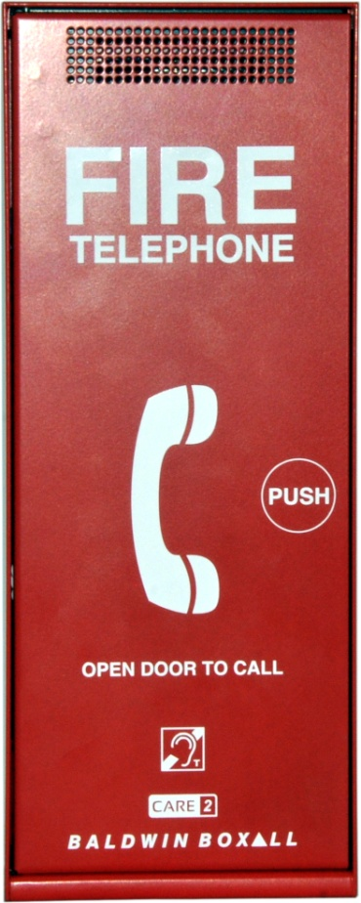
CARE2: Fire Fighter Telephone (Green Emergency/Steward Telephone also available)
Rugged red handset with hearing aid compatible earpiece.
Heavy duty enclosure.
‘Push door’ or ‘slot lock’ versions.
Full duplex speech.
Door latch initiates call.
Self-powered from line.
Red or stainless steel finish (or green ‘Emergency/Steward Telephone).
Surface or flush mountable.

Slide 27
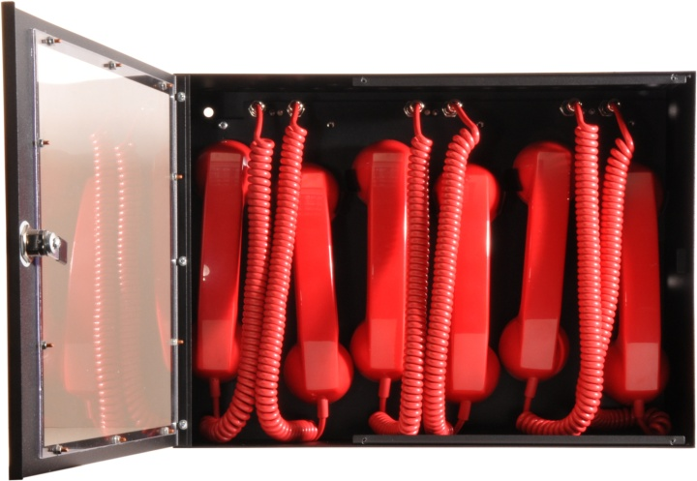
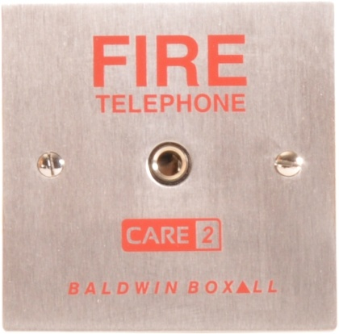
CARE2: Roaming Telephones
ENCLOSURE:
Holds up to six handsets.
Handsets are monitored whilst stored.
Lockable glass door.
Self powered from line.
Black or stainless steel finish.
HANDSET:
Robust unit with hearing aid compatible earpiece.
JACK SOCKET:
Stainless steel finish.
Can be paralleled on one line.

Slide 28
CARE2: System Features
Fully monitored at all times (including roaming telephone handsets stored in handset enclosure).
Battery-backed (will continue working in the event of mains power failure – 3 hours active plus 24 hours in standby).
Outstations are radial wired using fire rated two core cable.
Control and network panels are wired in a loop configuration using 2x two-core cable.
Local area set-up facility for NEPs.
Ethernet port for configuration diagnostics and accessing fault/activity log.
Optional link to fire detection system.
Call reassurance facility for toilet alarm.
Ideal for retro-fitting old star-wired systems.
Fully compliant to BS5839-9:2011.

Slide 29
CARE2: Typical Systems & Cabling

Slide 30
CARE2

Slide 31
CARE2

Slide 32
CARE2: Cable Requirements
Remote units are radial (star) wired configuration. Control/NEP panels are loop wired.
Two core fire resisting cables:
Disabled refuge – non-enhanced (refer to BS5839-9).
Fire fighter/roaming telephones – enhanced.
Two x two-core for network loop – enhanced (enhanced also recommended for disabled refuge systems).
Up to 500m cable run between remote units and control console as standard.
Maximum overall length of network = <5km.
Disabled refuge, fire fighter telephone, emergency/steward telephone, roaming telephone and disabled toilet alarm can be included on the same system.

Slide 33
The VIGIL Omnicare System

Slide 34
Omnicare: Addressable EVC system
The system is designed to be simple to install and operate.
Wired on a loop configuration.
Comprises of two main components:
Master Control Panel.
Remote Units (outstations):
Disabled refuge (DRS), advance disabled refuge, fire telephone, emergency/steward telephone, combined fire telephone/DRS and disabled toilet alarm.

Slide 35
Omnicare: Master Control Panels
Available to suit various sized systems:
Mini panel: 8-way to 32-way.
Standard panel: 48-way to 64-way.
Large panel: 80-way to 128-way.
Typically fitted in the ‘building management’ area of a building.
Receives ‘call’ or ‘occupancy’ signals from the remotes.
Provides voice communication with the remotes on the system.
Displays system status.
Can be flush or surface mounted.

Slide 36
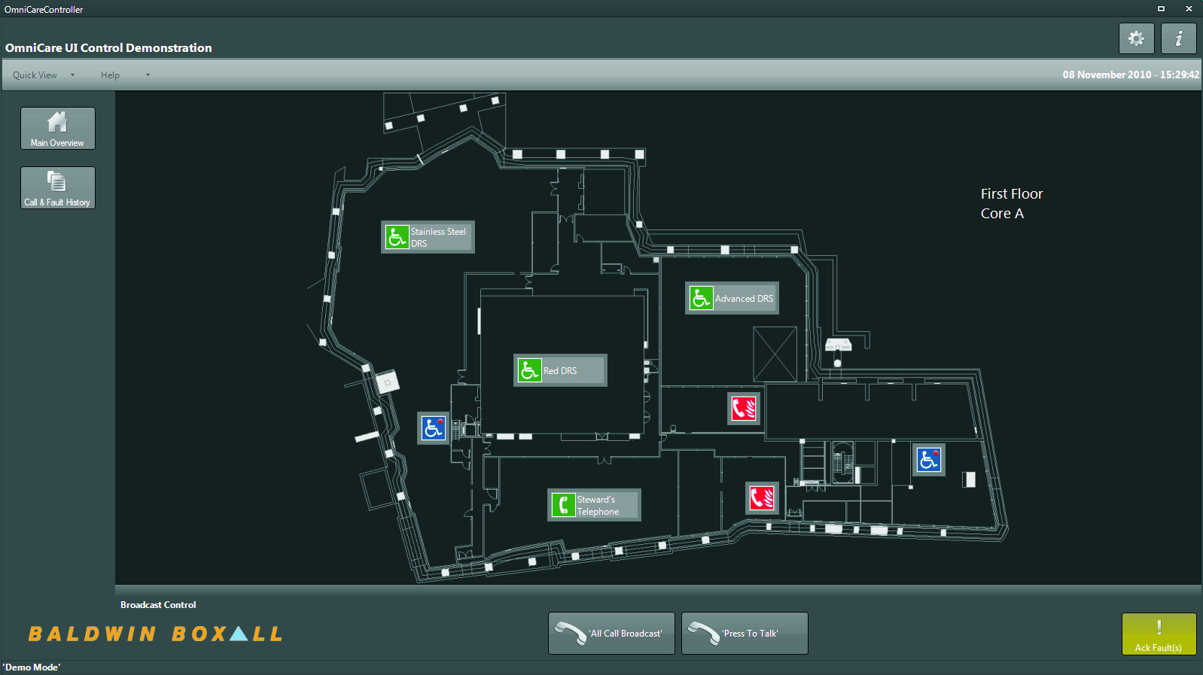
Omnicare: Touchscreen Control Option
Can be installed remotely from the master panel – providing a stylish option for reception/lobby areas.
Button or full graphic layout display.
Simple to navigate touchscreen control.
Suitable for single panel or networked systems.
‘Administrator’ and ‘guest’ password protected accounts.
High resolution LCD display with fingertip sensitivity.
Replicates the status of the master panel.
History and fault log with real time date stamp.

Slide 37
Omnicare: Disabled Refuge (DRS)
Self-powered from line.
Green or stainless steel finish.
Single button push to activate.
Hands-free, speech steered operation.
Call reset at control panel or key switch on remote.
Volt free contact to operate over-door lights, etc.
Green or stainless steel finish.
Surface or flush mountable.

Slide 38
Omnicare: Advance Disabled Refuge
Built-in induction loop.
Front panel features Braille, tactile and luminescent text.
Volt free contact to operate over-door lights etc.
Reset via the control panel or remote unit.
Green or stainless steel finish.
Surface or flush mountable.

Slide 39
Omnicare: Fire Telephone (Green Emergency/Steward Telephone also available)
Rugged red handset with hearing aid compatible earpiece.
Heavy duty enclosure.
‘Push door’ or ‘slot lock’ versions.
Full duplex speech.
Door latch initiates call.
Self-powered from line.
Red or stainless steel finish (or green ‘Emergency/Steward Telephone).
Surface or flush mountable.

Slide 40
Omnicare: Combined Unit
Combined unit featuring a fire telephone and disabled refuge in one housing.
Seen as one point on the control panel.
Self-powered from line.
Same features as individual the outstations.
Red or stainless steel finish.
Surface or flush mountable.

Slide 41
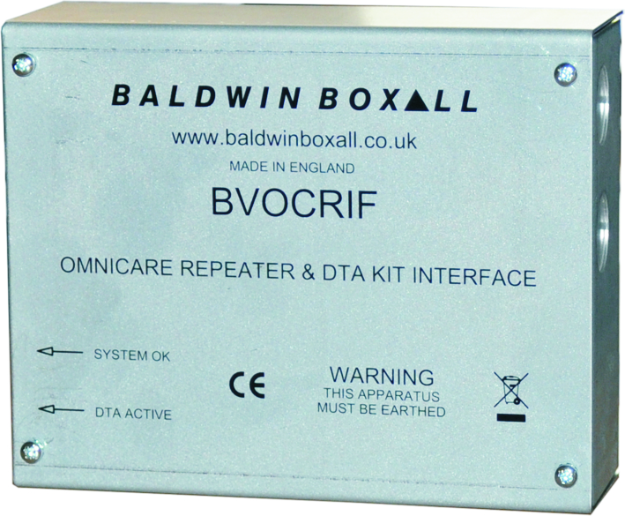
Omnicare: Repeater Unit
Enables connection of 3-part toilet alarm kit to the Omnicare system.
Acts as a booster unit to allow cable runs to exceed 200 metres.
Zintec steel finish.
Surface mountable.

Slide 42
Omnicare: DRS backbox options
Standard. Surface or flush mount with optional bezel.

Slide 43
Omnicare: DRS backbox options
Flush mount plasterboard backbox. Available with either a green or stainless steel bezel. (Can also be used with CARE2 when termination card is removed.)

Slide 44
Omnicare: DRS backbox options
Surface-mount IP66 rated enclosure. Enables placing of remotes in external areas such as balconies, etc. (Can also be used with CARE2 when termination card is removed.)

Slide 45
Omnicare: System Features
Fully monitored – as required by BS5839-9:2011.
Volt free contact for indicator or loudspeaker mute.
Long-distance, digital CANBUS technology.
Wired in a loop configuration.
The system will still fully function in the event of a break in a wiring loop.

Slide 46
Omnicare: Typical Systems & Cabling

Slide 47
Omnicare: Loop Wiring
Typical system placing any type of remote on a single loop.
Typically 20-30 remotes per single four-core loop.
Disabled toilet alarms are connected to the system via a repeater unit.

Slide 48
Omnicare: Loop Wiring
Typical network system, providing both local control or complete system control from ‘gatehouse’ master panel.

Slide 49
Omnicare: Cable Requirements
Enhanced fire rated cable – four-core, screened, LS0H, 1.5mm.
Recommend soft skinned, harmonised, FP200.
Maximum cable runs can be extended by using a repeater unit.
Brown: +24V
Blue: 0V
Grey: CAN H
Black: CAN L
Standard fire resisting cables could be considered suitable for:
EVC systems for use in (a) sprinklered buildings; (b) unsprinklered buildings less than 30m in height, provided that evacuation takes place in three or fewer phases.
Underground sections of cabling at sports and similar venues.

Slide 50
Omnicare: Typical Cable Runs
Cable diameter (FP200) | Number of remotes | Total cable length
1.5 mm | 10 | 2200 m
1.5 mm | 15 | 1900 m
1.5 mm | 20 | 1300 m
1.5 mm | 25 | 900 m
1.5 mm | 30 | 600 m
The above distances refer to a loop wired Omnicare system and assume that there is a break in the cable and the system is running off a near-discharged battery.

Slide 51
OmnicarePLUS: Large System Solution

Slide 52
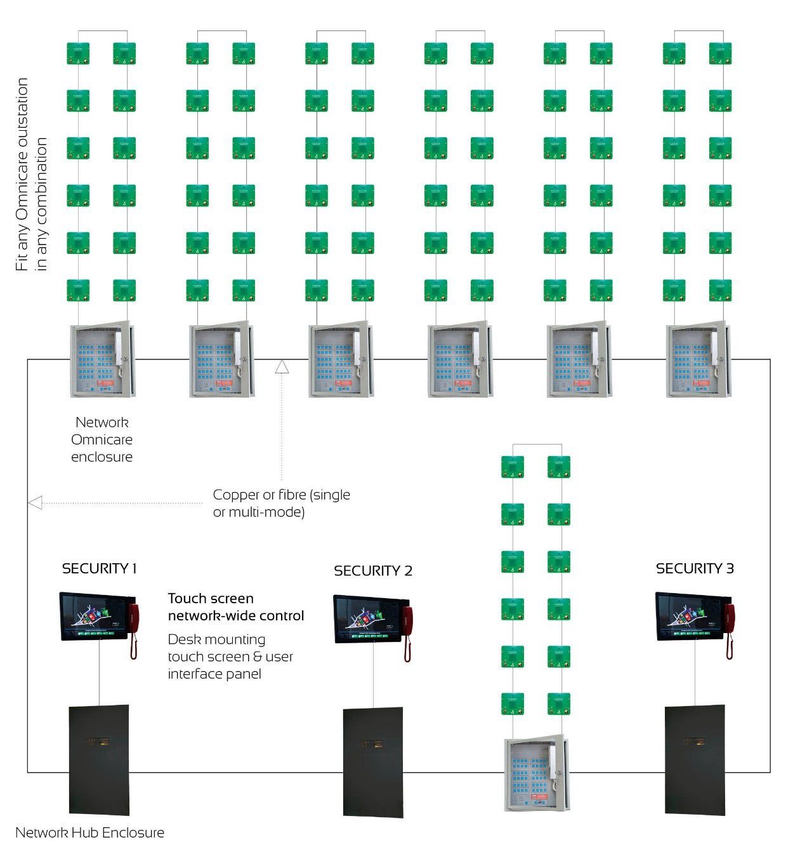
OmnicarePLUS: System Example
A complete solution that can be designed to suit your specification.

Slide 53
OmnicarePLUS: System Features
The system uses local area control panels – with up to 64 outstations per panel.
Overall master control is via means of computer-driven touch screen(s).
Simple, graphical layer control.
Can communicate with every outstation on the system.
Additional touch screen control points can be added as slave/mimic panels. Full control can be transferred to a slave if required.
Outstations can be any combination of units available in the Omnicare range.

Slide 54
OmnicarePLUS: System Features
Connect up to 126 ‘local’ panels – each with up to 64 outstations.
Compatible with the entire range of Omnicare outstations.
Choice of copper and fibre (single or multi-mode) networking.
Multi-layer graphical touch screen control – see the location of the remote calling.
Automatic incoming call queuing, with indication of number of waiting calls.
Multiple touch screen control locations, with optional mimicking of status and faults.
Incoming call logging and audio recording via touch screen control locations.
All site wiring fully monitored for faults.
Calls can be accepted locally at Omnicare panels.
Optional access control at touch screen control locations.

Slide 55
Disabled Toilet Alarm

Slide 56
Disabled Toilet Alarm
Toilet alarm system that works with our Omnicare and CARE2 EVC systems:
Powered from the line (no local power required
Combine a toilet alarm system with disabled refuge, fire telephones, steward telephones – all integrated to the one system
Call acknowledge feature
Monitored for faults and battery backed via the EVC system
Fully conforms to BS8300

Slide 57
New DTAKIT Components for ‘assistance call’ system (add to our BS8300 compliant toilet alarm)
DTA(S)CB – wall mounted call point
DTA(S)CBRP – wall mounted combined call/reset point
DTA(S)CPW – wall mounted pull cord
DTA(S)CBJ – wall mounted call point with connection for pear lead
Compatible with existing DTA kit components

Slide 58
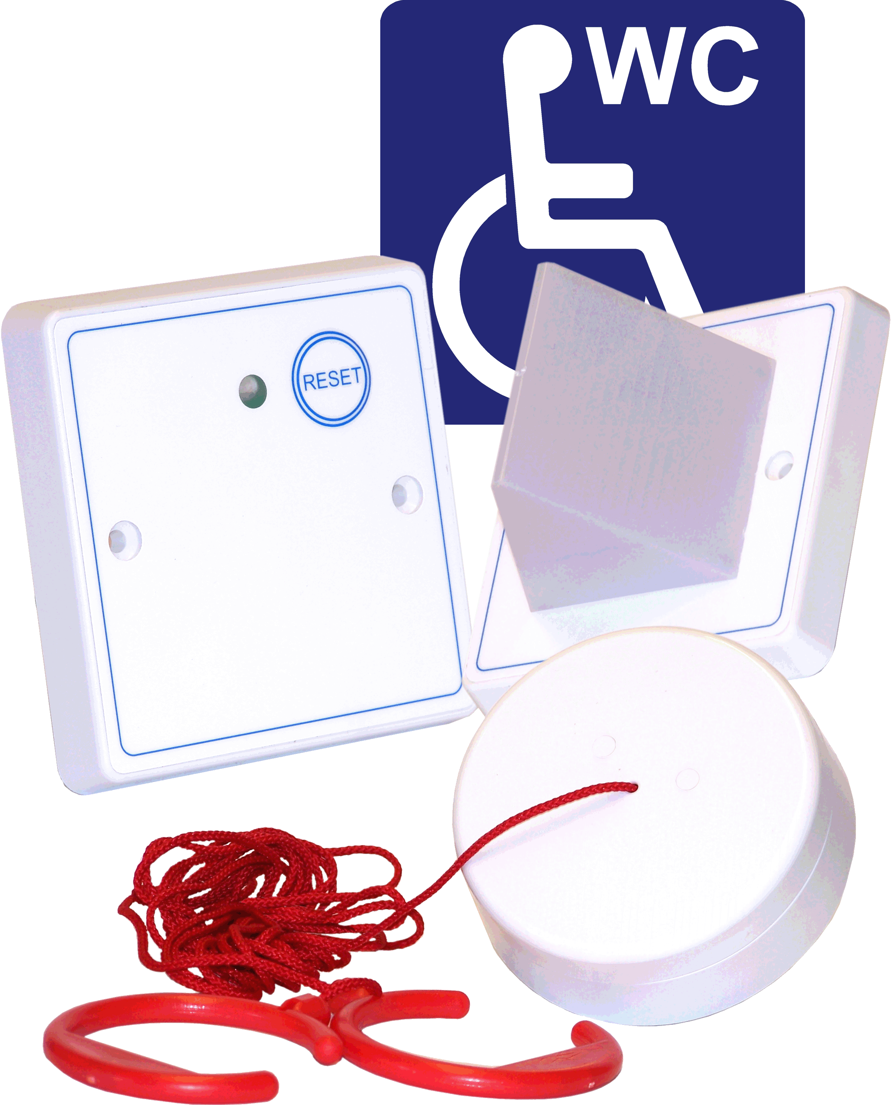
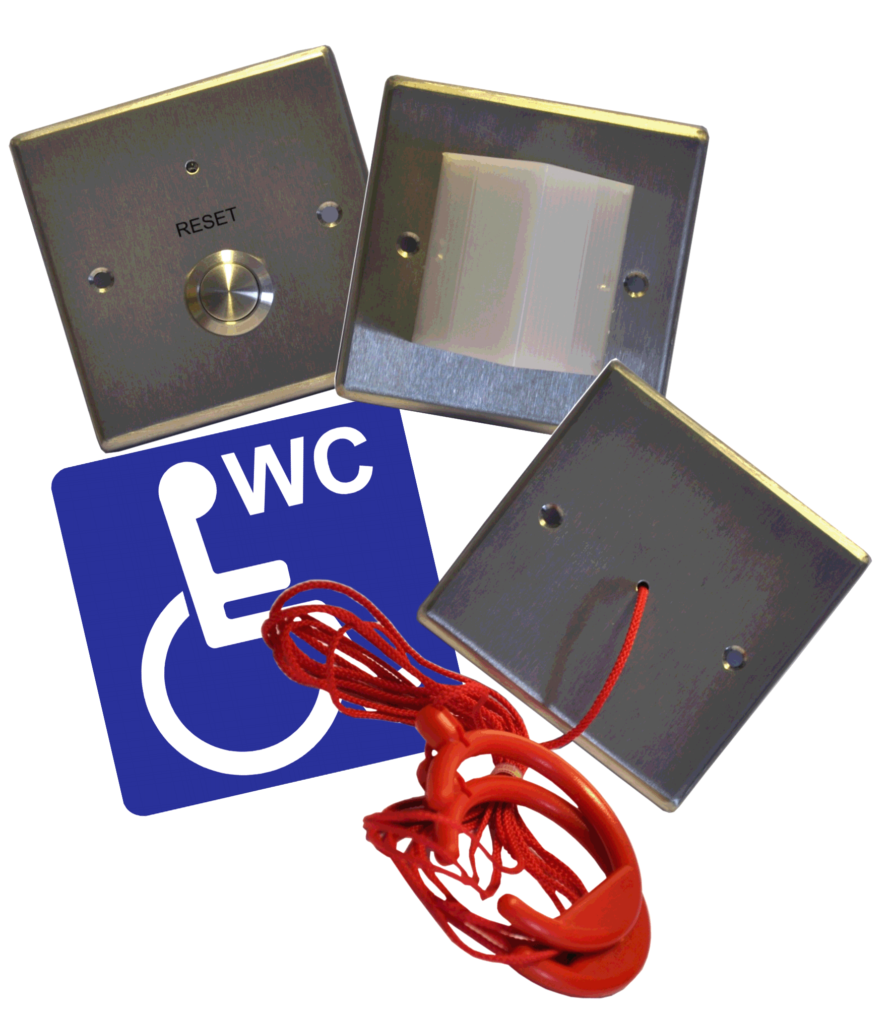
Toilet Alarm Controller stand-alone – four-way unit
Controls up to four of our DTAKITs
Fully BS8300 compliant
Built-in mains supply
Fits a standard two-gang box
Fault monitoring, call acknowledge, programmable re-sound delay

Slide 59
www.baldwinboxall.co.uk

